Slide 1

AstroSage Analysis
DHRUV KR. KESHRI
20th JULY 2025

Slide 2

ABOUT ASTROSAGE
Founded in 2000; launched AstroSage.com in 2004
India’s leading digital astrology platform
51M+ monthly users, 10M+ app downloads
Offers Kundli, horoscope, matchmaking, and daily predictions
Powers 80%+ of India’s online horoscope matching
Innovator in AI-based astrology (AstroSage AI, Kundli AI

Slide 3
PROBLEM STATEMENT
To optimize AstroSage’s call center operations through a strategic investment of ₹1 crore.
The primary goal is to determine the most effective allocation of this investment to enhance operational efficiency, customer satisfaction, and overall profitability
This study analyzes historical call records, performance metrics, and market dynamics to develop insights that enhance organizational decision-making and improve overall operational efficiency.

Slide 4
DATA OVERVIEW
Data collected from AstroSage’s consultation system, covering both calls and chats across platforms.
Covers consultations between December 2023 and January 2024.
Includes Agent Name, User ID, Call Time, Rating, Consultation Type, and Revenue for detailed analysis.
Removed unused or irrelevant columns to ensure clarity and maintain only essential fields for analysis.
Enables insights into agent performance, call trends, and platform usage, supporting better decision-making.

Slide 5

METHODOLOGY
Data Cleaning
Removed duplicates & failed sessions
Fixed missing values (duration, status)
Standardized date & time
Data Enrichment
Classified consultations (chat/call, refund)
Calculated avg. duration, earnings, ratings
Used Excel functions (VLOOKUP, IF, TEXT)
Analysis
Pivot tables: volume, revenue, performance
Trend analysis: frequency & ratings
Segmentation: users & regions
Tools :
Excel (processing & visualization)
Basic statistics (trend insights)

Slide 6
DAILY CALL VOLUME ANALYSIS
Insights from Visuals
Average Daily Call Volume
246 calls/day over the observed period of a healthy baseline for planning staffing and infrastructure
Peak Volume: Highest on Dec 11-13 (400+ calls/day).
Lowest Volume: Dec 8 (138 calls).
Holiday Dip: Lower calls on Dec 31 and Jan 1.
Weekdays > Weekends: Higher calls on weekdays (Dec 11-13.)

Slide 7
CUSTOMER SATISFACTION
Avg. Rating
Dec 2023: 2.95
Jan 2024: 2.68
Overall Avg.: 2.93
Key Insights :
Higher ratings in Dec (holiday offers / performance)
Drop in Jan → check quality & staffing issues
Continuous tracking needed for improvement

Slide 8
REVENUE GENERATED BY CONSULTAION TYPE
Total Sales by Consultation Type
Breakdown of Revenue
Call: ₹168,520.62
Chat: ₹45,494.68
Public Live Call: ₹50.60
Complementary: ₹0.00
Grand Total: ₹214,065.90
INSIGHTS
Calls generate ~79% of total revenue, making them the core business driver.
Chats contribute ~21%, offering room for growth and optimization.
Public Live & Complementary services add negligible revenue, mainly for engagement and retention.
Focus: Strengthen call-based services for higher ROI and expand chat revenue via upselling or bundling.

Slide 9
CHAT STATUS DATA
Key Insights :
Completed (5,535 Chats): High rating (7.01) & revenue (₹8.21) → satisfied & profitable.
Failed (7,256 Chats): No ratings, low revenue (₹1.09) → operational inefficiency.
Incomplete/Pending: Low ratings & revenue → user drop-offs or tech issues.

Slide 10
RATING WISE GURU DISTIBUTION
Key Insights :
7,256 gurus have a rating of 0, indicating they are new or unrated.
Many fall within the low rating range (1–3), suggesting a need for performance improvement.
Few gurus have high ratings (6–8), showing limited top performers.
This presents an opportunity for targeted training or mentoring.

Slide 11
SHIFT FOCUSED TOWARDS CALL BASED CONSULTATIONS
Key Insights :
Most calls are successfully completed, but about 59% are unanswered, busy, failed, or incomplete, indicating room for improvement in connectivity and call handling.
To improve the call completion rate, implement automated IVR calls for initial engagement and hire additional agents to handle higher call volumes effectively.

Slide 12
TOP-PERFOMING GURUS BASED ON RATING & EARNING
Key Insights :
Dr. Balkrisna tops total earnings (₹15,910.21) with strong efficiency.
Usha Siingh achieves the highest earnings per minute (₹15.36/min).
Astro Shalini leads in call duration but has moderate returns.
Tarot readers generally show better earning efficiency than astrologers.
Short, high-value consultations drive greater profitability overall.

Slide 13
DAILY CALL ACTIVITY
Key Insights:
The daily call volume fluctuates significantly, with both sharp rises and steep drops. No steady upward or downward linear trend, but rather seasonal peaks and troughs.
From 08-12-23 (138) to 09-12-23 (288): +150 calls (biggest jump).
From 13-12-23 (348) to 14-12-23 (226): –122 calls (sharp decline).
Drops are noticeable around weekends and holidays (07-08 Dec drop before spike, 30–31 Dec, 01 Jan).
Spikes tend to occur on weekdays mid-month (09–10 Dec, 15 Dec).

Slide 14
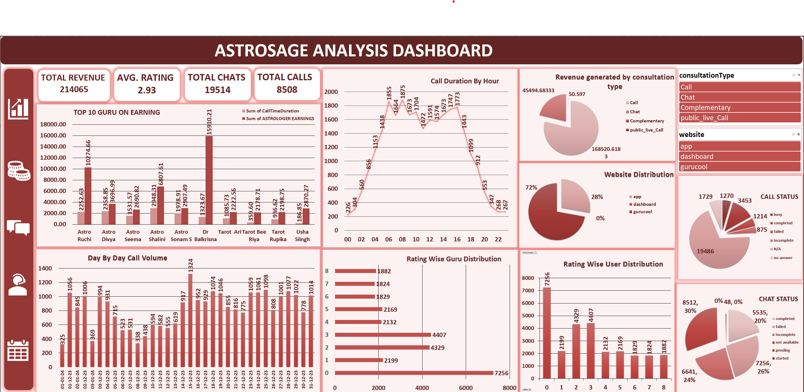
DASHBOARD

Slide 15
RECOMMENDATION
Enhanced Agent Training:Strengthen agent capabilities by focusing on consultation quality and faster issue resolution to improve customer satisfaction.
Optimize Call Duration:Identify the ideal call duration that balances efficiency with a positive customer experience.
Strategic Resource Deployment:Deploy top-performing agents during peak hours and assign them to handle complex cases for consistent service excellence.
Integrate Customer Feedback:Continuously analyze customer feedback to detect recurring issues and leverage insights for service enhancement.

Slide 16
CONCLUSION
Calls Drive Revenue: Most profitable channel → focus on UX & infrastructure.
High Session Failures: Incomplete calls → lost revenue; need better backend & call flow.
Top Gurus Boost Retention: High-rated gurus → model success & promote them.
Uneven Demand: Fluctuating call volume → predictive staffing & flexible resources needed.
Upskilling Needed: Performance gaps → targeted training & incentives for consistency.
Closing Statement :
Data-driven roadmap to make AstroSage’s call center more efficient, high-performing, and customer-centric.
Strategic investments guided by insights will improve service quality, satisfaction, and drive measurable business growth.

Slide 17
ACKNOWLEDGEMENT & REFRENCE
ASTROSAGE ANALYSIS REPORT 2023-24
Founder/Author: Pt. Arun Kumar Bansal
Website: www.astrosage.com

Slide 18
THANK YOU

